Slide 1
CMOS Process
Tyndall 10V 1.5micron Process

Slide 2
Starting Material
P on P+ epi material
Pseudo twin well process
All furnace ramps in this process are up from 800ºC and down to 800ºC
10µm
P- Epi 10- 16ohm.cm
Some dimensions in Angstroms
1A=10nm
525µm
P+ Substrate

Slide 3
Zero Level Alignment Mark
A mark is etched into the silicon for use as an alignment target
Photoresist
Oxide 520Å
10µm
P- Epi 10- 16ohm.cm
Initial Oxide
Temp 975ºC
Time 90min
Gas O₂
Target Tox 52nm
Ramp up 20min O₂
Ramp down 30min N₂
525µm
P+ Substrate

Slide 4
NWell Mask and Implant
Phosphorous Implant 4e12 @ 170kV
Resist
PWell is the inverse of the NWell
That is the NWell is drawn and the PWell mask is generated from it

Slide 5
PWell Mask and Implant
Boron Implant 8e12 @ 40kV
Resist
Pattern the resist
PWell areas exposed
Resist protects NWell areas
Resist stripped after implant

Slide 6
Twin Well Drive
Well Drive
Ramp up 30min/N₂
Temp 1100ºC
Time 22hrs/N₂
Time 120min/O₂
Ramp down 60min/N₂
Strip grown oxide
The original epi interface is now about 4µm deep because of up diffusion of boron
P- Well
N- Well

Slide 7
LOCOS Process 1
Pad Oxidation
Temp 900ºC
Time 152min/O₂
Time 20min/N₂
Ramp up 10min/O₂
Ramp dn 20min/N₂
100nm Nitride Deposition
Temp 800ºC
Time 33min approx
100nm LPCVD Silicon Nitride
35nm Silicon Dioxide
Resist
P- Well
N- Well

Slide 8
LOCOS Process 2
P- Well
N- Well
Etch the nitride, stop on the oxide
Strip the resist

Slide 9
Boron Field Mask and Implant
Implant Boron 7e13 @ 15kV
Resist
P- Well
N- Well
Boron is implanted into the field areas of the PWell to increase the surface doping concentration

Slide 10
Phosphorous Field Mask and Implant
Phosphorous Implant 2e12 @30kV
Resist
P- Well
N- Well
Phos is implanted into the non-active NWell areas

Slide 11
LOCOS 3 Field Oxide Growth
Field oxidation
Temp 1000ºC
Time 60min/N₂
Time 180min/Wet H₂ /O₂
Time 5min /O₂
Time 10min /N₂
Ramp up 20min /N₂
Ramp dn 40min /N₂
Target Tox 700nm
Remove nitride
P- Well
N- Well

Slide 12
Sacrificial Oxide Growth and Vt Adjust Implant
Implant Boron 1.2e11 @ 30kV
Grow SAC oxide 28nm
Temp 950ºC
Time 24min /O₂
Time 16min /O₂ -TCA
  cannot be modelled, take as O₂
Time 20min /N₂
Ramp up 18min /O₂
Ramp dn 30min /N₂
Target Tox 28nm
Implant Vt adjust
Strip SAC oxide
P- Well
N- Well

Slide 13
Gate Oxidation
Grow Gate Oxide 28nm
Exact same cycle as the SAC oxide previous slide
P- Well
N- Well

Slide 14
Polysilicon Deposition
Deposit 450nm Polysi
Temp 620ºC Time 45-50min
P- Well
N- Well

Slide 15
Polysilicon Doping
Dope the poly with phos
Temp 900ºC
Time 10min N₂(4l/m)/O₂(95ml/m)
Time 90min (POCl₅) N₂(95ml/m)/O₂(95ml/m
Time 10min N₂(4l/m)/O₂(95ml/m)
Ramp up 10min N₂
Ramp dn 20min N₂
Pattern the poly mask
P- Well
N- Well

Slide 16
Etch Polysilicon
P- Well
N- Well
Etch the poly leaving the tracks behind
Strip the resist

Slide 17
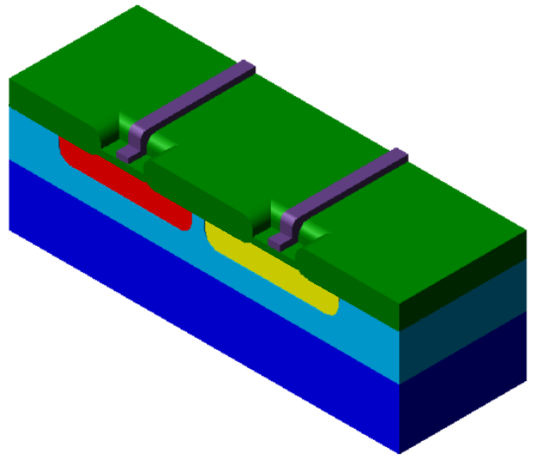
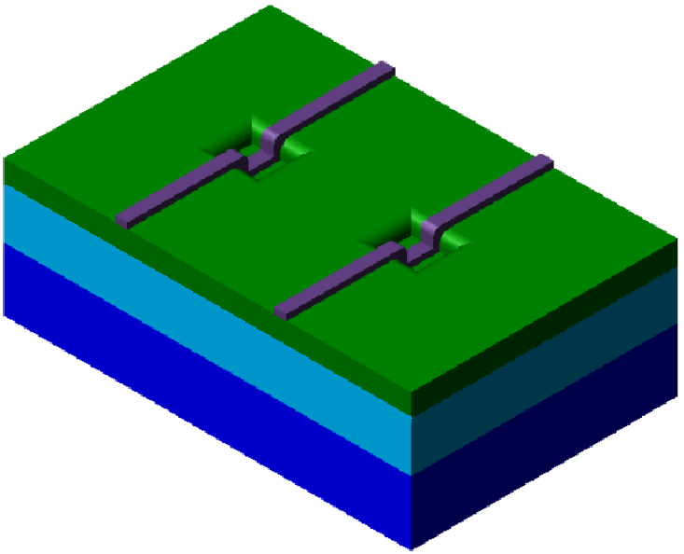
3-D View

Slide 18
Poly Oxidation
Polysilicon is reoxidised
Temp 900ºC
Stabilisation Time 20min N₂(4l/m)/O₂ (1.8l/m)
Time 105min O₂
Ramp up 10min N₂(4l/m)/O₂ (1.8l/m)
Ramp dn 20min N₂
P- Well
N- Well

Slide 19
Polysilicon Capacitor Formation
Capacitor
By adding a second layer of polysilicon (200nm) and doping it
A poly-poly capacitor can be formed between the 2 levels of polysilicon
These capacitors are only allowed in the field areas. They are not allowed over active area
P- Well
N- Well

Slide 20
N+ Source/Drain Mask and Implant
P- Well
N- Well
Implant Phos/As for the N+ source/drains
Phos 5e13@110keV
As 6e15@110keV
The poly protects the channel areas

Slide 21
N+ Anneal
N+ anneal of the implant
Temp 900ºC
Time 60min N₂
Ramp up 5min N₂
Ramp dn 20min N₂
P- Well
N- Well

Slide 22
P+ Source/Drain Mask and Implant
P- Well
N- Well
Boron is implanted into the P+ S/D regions
Boron 4e15@15keV

Slide 23
Deposit BPSG Reflow and Anneal
BPSG deposition
  350
  4% B - 4%P
Reflow Anneal
Temp 900ºC
Time 3min O₂
Time 5min H₂/ O₂
Time 3min O₂
Time 30min N₂
Ramp up 10min O₂
Ramp dn 20min N₂
P- Well
N- Well

Slide 24
Contact Mask and Etch
P- Well
N- Well
Contact holes are etched with a taper etch through to the S/D and the polysilicon
This is a dry etch process (RIE)

Slide 25
Plan View of Contact Location
C
All previous cross-sections through A-B
The Polysilicon contact is not made in the thin ox/active area, but on the field oxide area
Poly contact cannot be seen in the A-B cross section
See C-D section next slide
A
B
D

Slide 26
C-D Cross-Section Showing Polysilicon Contact

Slide 27
Sputter Mask and Etch Metal 1
P- Well
N- Well
0.5µm Aluminium/0.5% Silicon is sputtered on the wafer surface
Patterned and then etched

Slide 28
Deposit Interlevel Dielectric mask and Etch vias
Most modern small geometry processes will have more than 1 level of metal ours uses a Spin on Glass
SOG sinter
Temp 425ºC
Time 75min N₂
P- Well
N- Well

Slide 29
Metal 2 Sputter Mask and Etch
1.0µm of aluminium silicon is deposited for metal 2
The Wafers are then alloyed or sintered
Alloy
Temp 400ºC
Time 15min N₂
Time 60min N₂/ H₂
Time 5min N₂
P- Well
N- Well

Slide 30
Finished Product
Metal 2
Metal 1
Interlevel Dielectric
Interlevel Dielectric
Field Oxide
P- Well
N- Well
Polysilicon
P-Channel Device
P+ S/D
N+ S/D
N-Channel Device

Slide 31
Metal Gate Field Device
S
G
D
A channel can be inadvertently formed in the field areas
It is important that this device is not turned on
P- Well

Slide 32
Polysilicon Gate Field Device
S
D
G
Poly gate device should have a lower threshold than the metal gate device
Threshold of the field devices should be higher than the power supply voltage
P- Well

Slide 33
